Slide 1
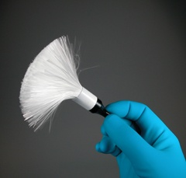
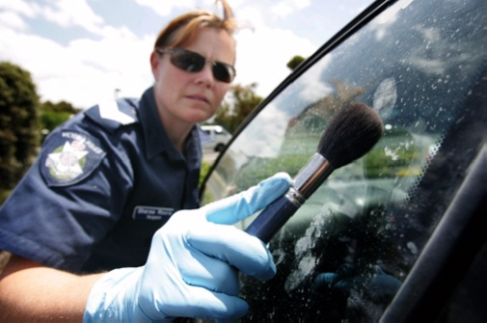
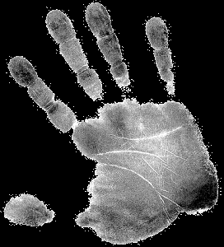
Developing Fingerprints

Slide 2

What causes latent prints?
The patterns of friction ridges contain rows of sweat pores that allow sweat and or oil to exit from glands. Sweat mixed with other body oils and dirt produces fingerprints on smooth surfaces.
Fingerprints are left by the transfer of oils, amino acids, ions, etc. to a surface

Slide 3

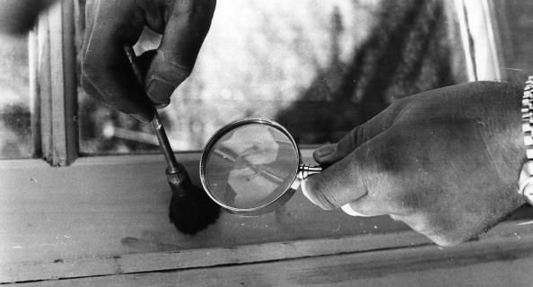
What Does Developing Prints Mean?
Making latent prints visible to the naked eye

Slide 4
At the scene, if there is a small item that is believed to have prints…

Slide 5
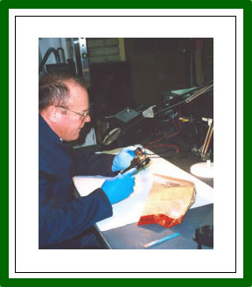
It should be collected and brought to the latent print unit of the crime lab.

Slide 6
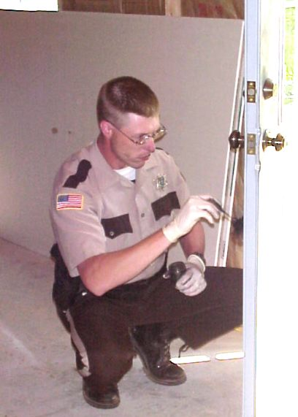
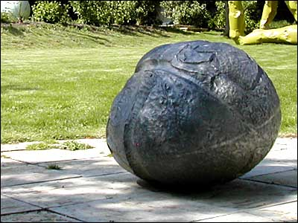
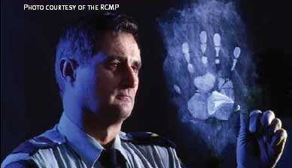
If an object is very large or cannot be moved…
We must apply latent fingerprint developing techniques at the scene

Slide 7
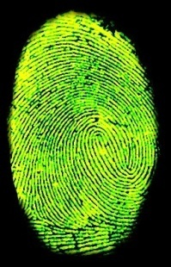

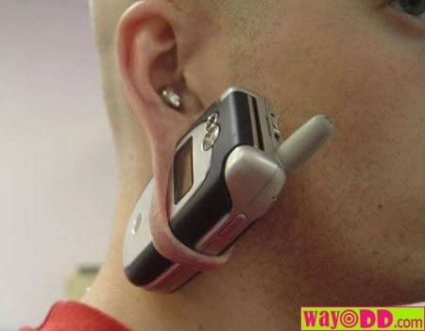
If small object (ie cellphone)
Wrap it in cellophane
Bring it to crime lab

Slide 8
If large object…
Develop the latent prints at the crime scene
Then…

Slide 9
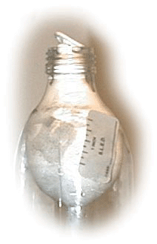
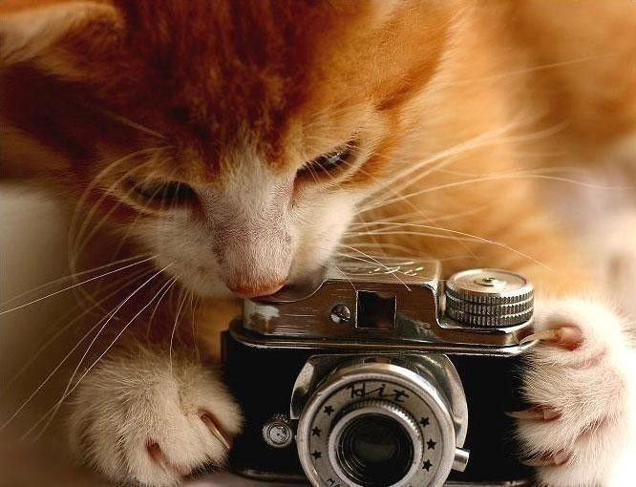
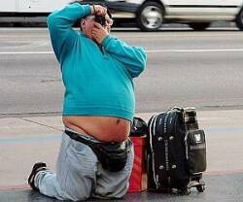
Preserve Developed Prints
After we dusted or developed them in another way…
Take Photographs!!!!

Slide 10
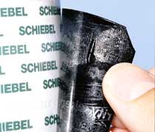
Then…
Lift the prints using tape
Apply to an appropriate backing

Slide 11
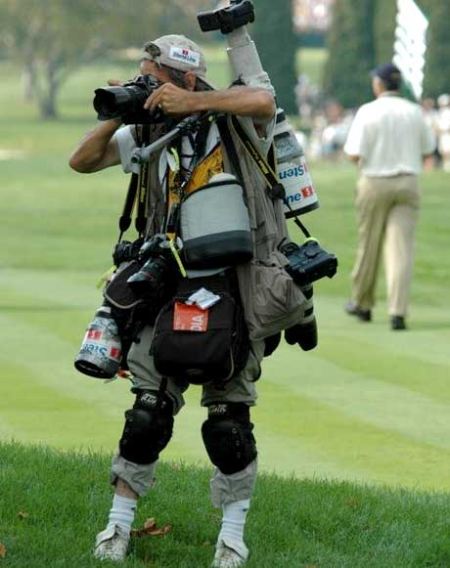
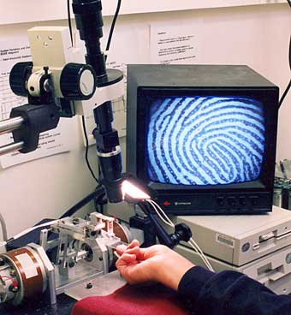
If we cannot take the object or cannot lift the prints…
The picture will be the only record of the print

Slide 12
Developing Latent Prints
Developing a print requires substances that interact with secretions that cause the print to stand out against its background. It may be necessary to attempt more than one technique, done in a particular order so as not to destroy the print.
  Powders—adhere to both water and fatty deposits. Choose a color to contrast the background.
  Iodine—fumes react with oils and fats to produce a temporary yellow brown reaction.

Slide 13
Developing Latent Prints
  Ninhydrin—reacts with amino acids to produce a purple color.
  Silver nitrate—reacts with chloride to form silver chloride, a material which turns dark when exposed to light.
  Cyanoacrylate—“super glue” fumes react with water and other fingerprint constituents to form a hard, whitish deposit.
In modern labs and criminal investigations, lasers and alternative light sources are used to view latent fingerprints. These were first used by the FBI in 1978. Since lasers can damage the retina of the eye, special precautions must be taken.

Slide 14

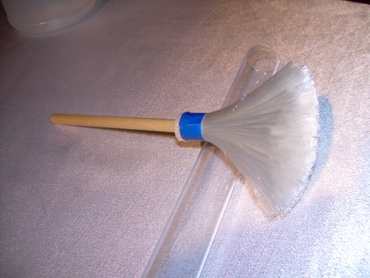
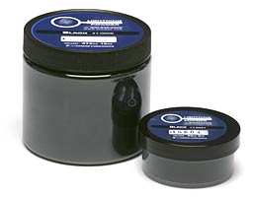
FINGERPRINT POWDER
Hard and non-absorbent surfaces like glass, painted wood, tiles or metal are usually dusted with fingerprint powder, which sticks to the traces of oil and perspiration left by the fingertip.
The powder is made in different colors so that investigators can select the one that provides the sharpest contrast with the surface being dusted.
Black powder, which consists of black carbon or charcoal, is applied to white or light-colored surfaces.
White powder, composed of aluminum dust, is used on dark-colored surfaces.
Fluorescent powder can also be used, and this is photographed under ultraviolet light so that the fluorescing latent print will stand out even against the most brightly colored or patterned surface.

Slide 15

CHEMICAL METHODS
Soft or porous surfaces such as cloth or paper can yield fingerprint evidence through the use of chemical methods.
There are four chemical methods used to visualize latent fingerprints:
(1)
Iodine fuming
(oldest method)
(2)
Ninhydrin
(3)
Silver nitrate
(4)
Superglue fuming
Chemical fingerprint developing kit

Slide 16
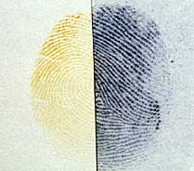
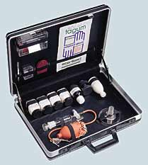
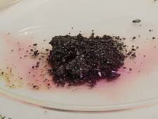
1) IODINE FUMING
The article is examined by being placed inside an enclosed cabinet with iodine crystals and then heated.
The iodine vapor given off by the crystals combines with traces of the print in a chemical reaction that leaves a visible pattern.
Once the process is stopped, the print will begin to fade.
The print must be photographed immediately or sprayed with a solution of 1% starch and 99% water. This solution will turn the print blue in color and make it last for several weeks.
Iodine Fuming Print
Iodine Fuming Kit
Iodine crystals

Slide 17
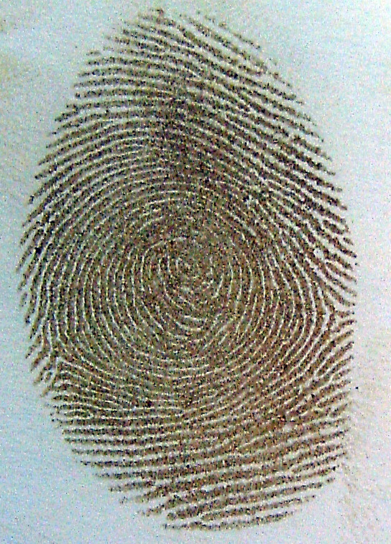
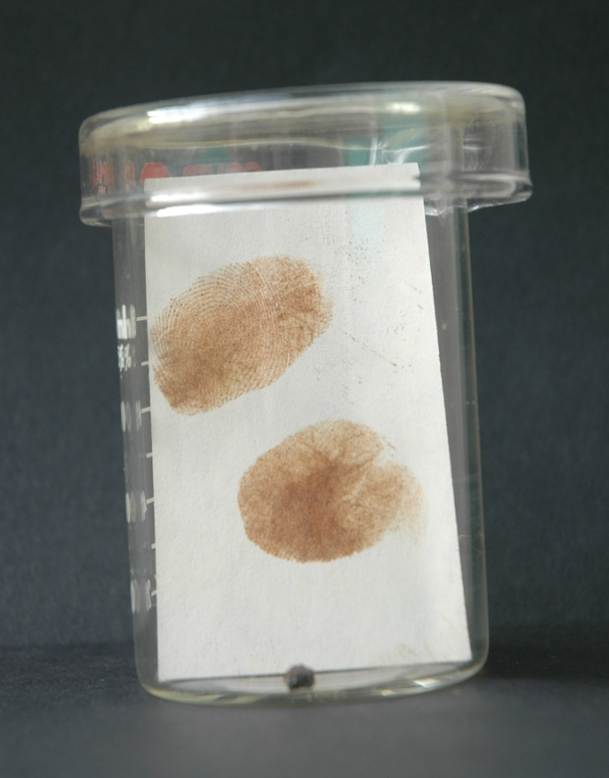
Iodine Fingerprint

Slide 18
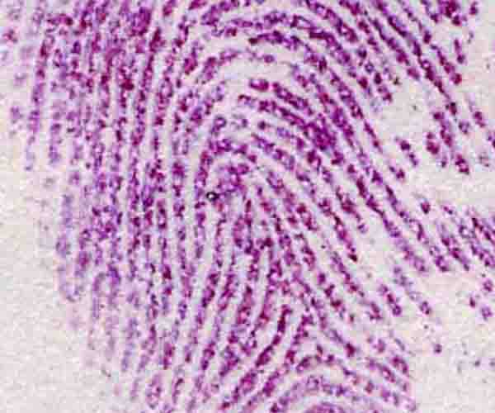
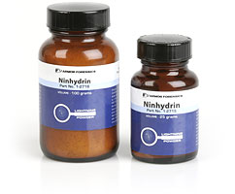
2) NINHYDRIN
Ninhydrin spray forms a purple-blue color when combined with traces of amino acids in human perspiration.
Applied by spraying onto a porous surface with an aerosol can.
Prints begin to appear within an hour or two, and can be developed faster if they are heated in an oven or on a hotplate at a temperature of 80○ to 100○ Celsius.
Ninhydrin Print
Ninhydrin Crystals

Slide 19
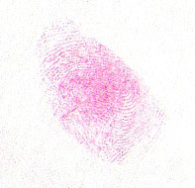
Ninhydrin Fingerprint

Slide 20
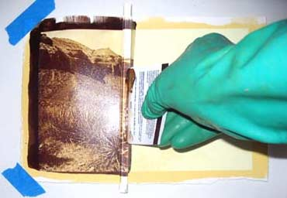
3) SILVER NITRATE
Silver nitrate reacts with the salt in perspiration to form silver chloride, which in turn is revealed under ultraviolet light.
The print will appear as a reddish-brown or black color.
Silver Nitrate Print

Slide 21
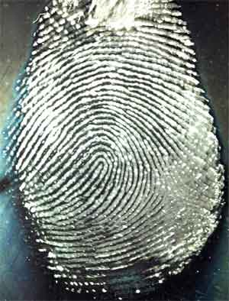
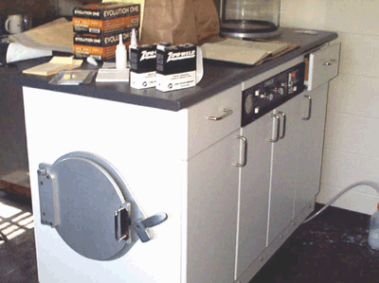
4) SUPERGLUE FUMING
Superglue fuming is a newer technique that relies on cyanoacrylate ester, the active ingredient in this type of very strong, quick-acting adhesive.
The fumes can be applied by heating the object in a closed cabinet or by filling the hole of a closed space, such as the interior of an automobile, with fumes to reveal every latent print.
Superglue Fuming Chamber
Print Developed Using Superglue

Slide 22
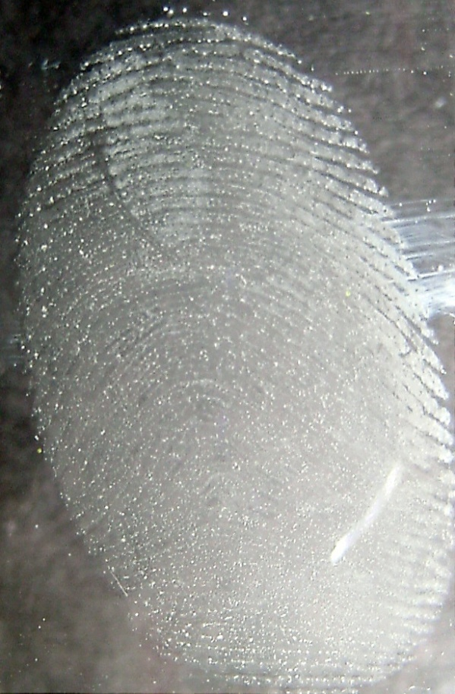
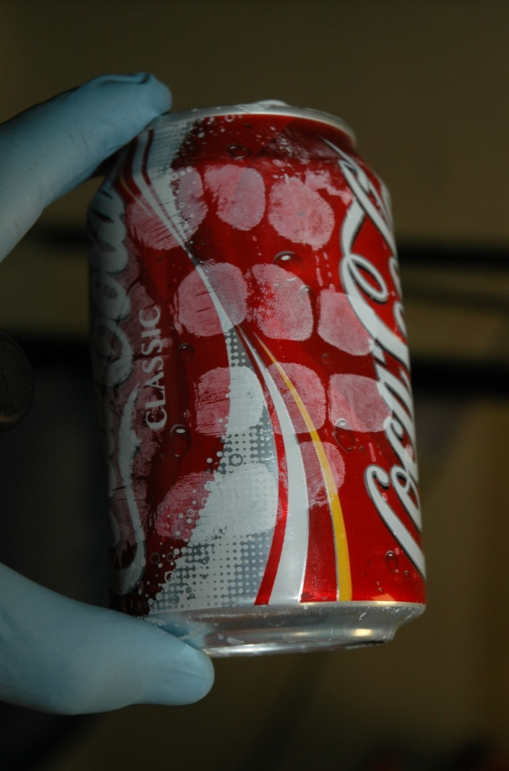
Cyanoacrylate Fingerprints

Slide 23
IF MORE THAN ONE METHOD IS USED...
If more than one method is used to develop prints, the order in which the techniques are used is important. The following order should be used to develop fingerprints:
This is the procedure used for optimal visualization because Iodine fuming is not permanent.
If Ninhydrin fails, silver nitrate can be used but it will wash away all the fatty oils and proteins from the surface.
Superglue fuming, if used, must be used last.
(1)
Iodine fuming
(2)
Ninhydrin
(3)
Silver nitrate
(4)
Superglue
fuming

Slide 24
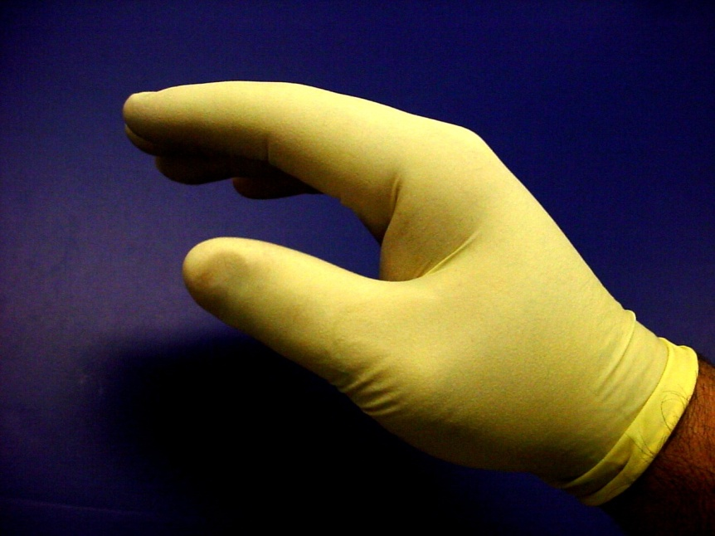
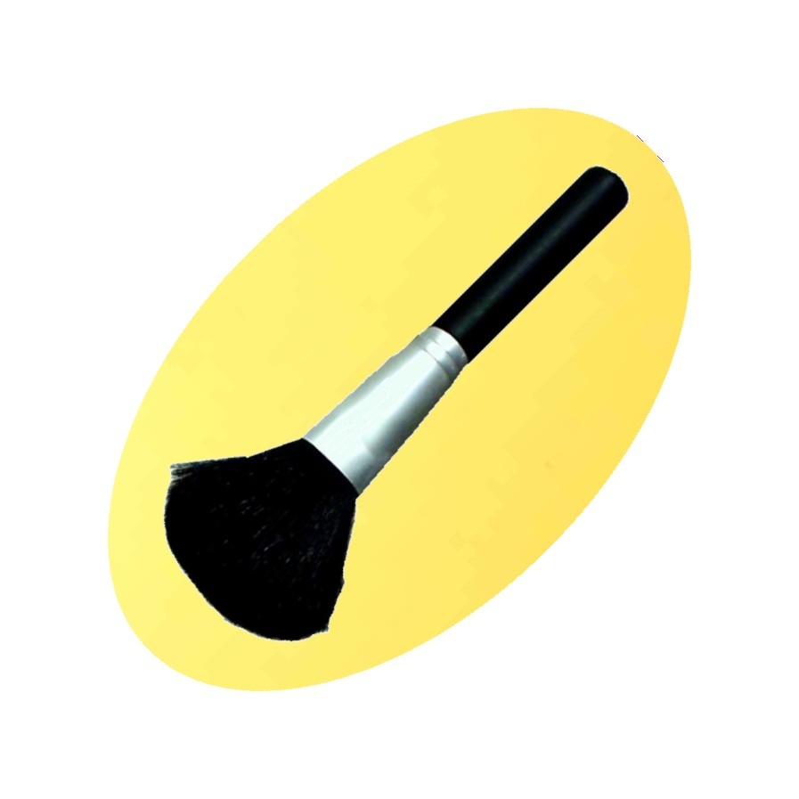
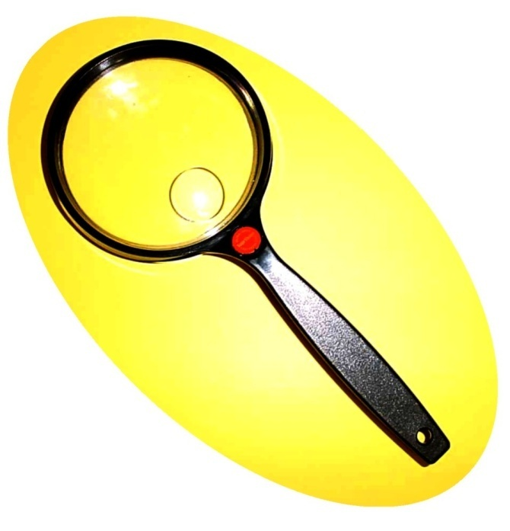
Questions?
bsapp.com

